Slide 1
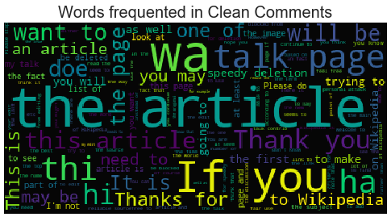
MALIGNANT COMMENTS CLASSIFIER PROJECT
SUBMITTED BY:
JASMINE KAUR
FLIP ROBO TECHNOLOGIES
DATA SCIENCE INTERN
INTERNSHIP 18

Slide 2
INTRODUCTION
The proliferation of social media enables people to express their opinions widely online.
However, at the same time, this has resulted in the emergence of conflict and hate, making online environments uninviting for users.
Although researchers have found that hate is a problem across multiple platforms, there is a lack of models for online hate detection.
Online hate, described as abusive language, aggression, cyber bullying, hatefulness and many others has been identified as a major threat on online social media platforms.
Social media platforms are the most prominent grounds for such toxic behaviour.

Slide 3
MULTI-LABEL VS MULTI CLASS CLASSIFICATION
In multi-class classification, the data can belong to only one label out of all the labels we have. For example, a given picture of an animal may be a cat, dog or elephant only and not a combination of these.
In multi-label classification, data can belong to more than one label simultaneously. For example, in our case a comment may be malignant, threat or loathe at the same time. It may also happen that the comment is positive/neutral and hence does not belong to any of the six labels.

Slide 4
DATA SOURCES AND THEIR FORMATS
We were provided with a dataset that contains a training dataset which has around 159000 sample points and a test dataset which has around 153000 sample points.
All the samples in training dataset contain 8 field namely ‘ID’, ‘ comments’, ’Malignant’, ’Highly Malignant’, ’Rude’, ’Threat’, ’Abuse’, and ‘Loathe’.
The label column is created that can be either 1 or 0. Label 1 denotes if there is at least one sort of bad language used in the comment and Label 0 is used when the comment is either positive or neutral.

Slide 5
LIBRARIES USED

Slide 6
DATA PRE-PROCESSING
Replaced the extra lines or ‘\n’ from the text.
Transform the text into lower case.
Replaced the email addresses with the text ‘emailaddress’.
Replaced the URLs with the text ‘webaddress’.
Removed the numbers.
Removed the HTML tags.
Removed the punctuations.
Removed all the non-ascii characters.
Removed the unwanted white spaces.
Removed the remaining tokens that not alphabetic.
Removed the stop words.

Slide 7
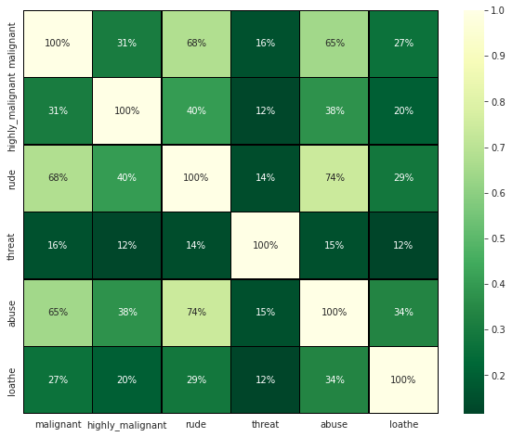
CORRELATION

Slide 8
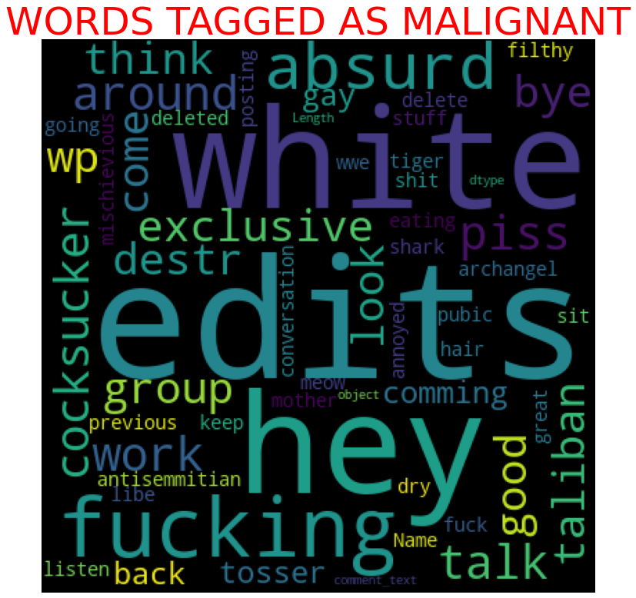
PLOTTING THE WORDCLOUD(Malignant)

Slide 9
MODELS/DEPLOYMENT AND EVALUATION
We have separated the independent and dependent features and converted the data into number feature
Splitted the training and testing data, along with handling the imbalanced dataset using RandomOverSampler.
We completed model building process.

Slide 10
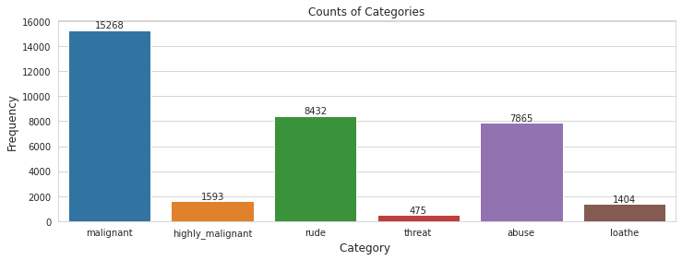
DATA VISULATIZATION(Count of different comment types)

Slide 11
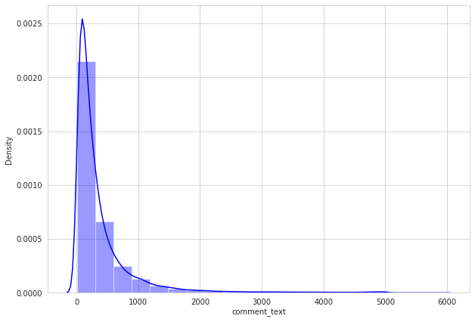
DATA VISUALIZATION(Number of words in comment text)

Slide 12
EVALUATION
Since the difference between the accuracy score and cross validation score is minimum in the case of random forest classifier and also its loss is very less. So, we will try hyperparameter tuning on Random Forest Classifier.

Slide 13
CONCLUSION
After the completion of this project, we got an insight of how to process the data, analyse the data, and build a model.
First we imported both the training and testing data, both of them were huge in size.
We did all the required pre-processing steps like checking the null values, datatypes, dropping unnecessary coloumns etc.
We used the training data for doing EDA using various plots and recorded the observations.
While observing the results, we found that the dataset was in highly imbalanced side and we need to handle it, in order to avoid the problem of overfitting.
Using NLP, we pre-processed the comment text.

Slide 14
CONCLUSION(Cont.)
As the problem was a multi-label classifier, we took a new feature known as label and combined the comment_labels output together using sum() and stored in that feature. For a binary classification problem, we scaled the data accordingly.
After applying vectoriser, we used an oversampling technique called RandomOverSampler for handling the imbalanced data.
We, then split the data using train_test_split and then we started the model building process by running as many algorithm in a for loop, with different metrics like cross_val_score, confusion_matrix, auc_score, log loss, hamming loss.
We found that RandomForest Classifier is performing best. So, we applied hyperparameter tuning on it. We got 95% score after performing it.
We saved the model and stored in csv file.

Slide 15
THANK YOU

